Slide 1



June 18, 2014
Experience API Data Reporting
Steven Vergenz, Mick Muzac
Contractors with Katmai Support Services
Supporting the ADL Initiative

Slide 2
More Info
xAPI Dashboard
https://github.com/adlnet/xAPI-Dashboard
NVD3
http://nvd3.org/
D3.js
http://d3js.org/

Slide 3
Download Tutorial Package
Session contents may be downloaded in its entirety at
Address
Developers may open the template.html file in the code directory and code along
Documentation is located in the docs directory
Checkpoint files are located in the code directory

Slide 4
Sample Statement
{
"actor": {
"mbox": "mailto:gia.creech@myschool.edu",
"name": "Gia Creech"
},
"verb": {
"id": "http://adlnet.gov/expapi/verbs/answered",
"display": {
"en-US": "answered"
}
},
"object": {
"definition": {
"name": "final/q49"
},
"id": "http://myschool.edu/xapi/cop-3223/final/q49"
},
"result": {
"success": false
}
}

Slide 5
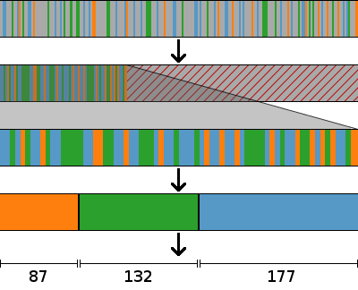
Processing xAPI Statements
Raw xAPI statements
Separate relevant statements from irrelevant
Throw out irrelevant statements
Gather like statements into groups
Aggregate each group into a single meaningful value

Slide 6
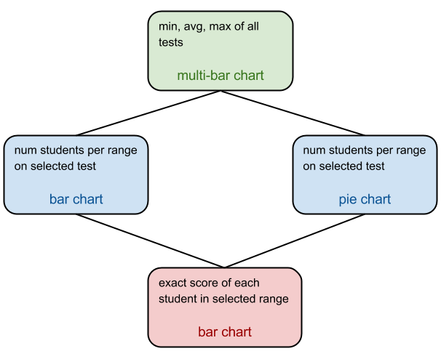
Dashboard Hierarchy

Slide 7

Contact Us
Steven Vergenz
Mick Muzac
Contractors with Katmai Support Services
Supporting the ADL Initiative
steve.vergenz.ctr@adlnet.gov
mick.muzac.ctr@adlnet.gov

